Slide 1
GNU Make
A program for directing compilation

Slide 2
What is Make
Make is a tool which controls the generation of executables
and other non-source files of a program from the program's source files.
The make utility automatically determines which pieces of a large program need to be recompiled, and issues commands to recompile them.

Slide 3
Capabilities of make
Make enables the end user to build and install your package
without knowing the details of how that is done.
Make figures out automatically which files it needs to update, based on which source files have changed.
Make is not limited to any particular language.

Slide 4
Need for Make Utility
Minimizes time for rebuilds.
Minimizes time for retyping the large commands

Slide 5


How to use make
Form the dependency tree that describes the relationships among files in your program and provides commands for updating each file.
Represent dependency tree using rules in make script file that tells make what to do.

Slide 6
Rules of a makefile
A makefile consists of "rules" with the following syntax:
target ... : prerequisites ...
<TAB>command
<TAB>...
<TAB>...

Slide 7
Rules of a makefile
target ... : prerequisites ...
<TAB>command
<TAB>...
<TAB>...
A target is usually the name of a file that is generated by a
program examples of targets are executable or object files.
A target can also be the name of an action to carry out, such as `clean' .

Slide 8
Rules of a makefile
target ... : prerequisites ...
<TAB>command
<TAB>...
<TAB>...
A prerequisite is a file that is used as input to create the target. A target often depends on several files.
A command is an action that make carries out. A rule may have more than one command, each on its own line.

Slide 9
A Rule says two things
How to update the target file.
How to decide whether target is out of date : it is out of date if it does not exist, or if either of prerequisites are more recent than it.

Slide 10
Example file
app: app.o stack.o list.o
  gcc –o app app.o stack.o list.o
app.o: app.c list.h stack.h
  gcc –c -Wall -O2 app.c
stack.o: stack.c stack.h list.h
  gcc –c -Wall -O2 stack.c
list.o: list.c list.h
  gcc –c -Wall -O2 list.c

Slide 11
Make command line
The following shell command performs all necessary recompilations whenever any source file is modified
$ make [ -f makefile ] [option] … target …

Slide 12
How make Processes a makefile
Make starts with default goal
Decide whether target is out of date
    -> If no prerequisites , it is always out of date – phony targets
    -> If prerequisite(s) are specified but doesn’t exist, search for
    the rule whose target matches with it and decide whether out
    of date.
    -> If prerequisite(s) are specified and also exist, if modification time stamps of prerequisites is greater than that of target, target is out of date.
If target out of date , execute the commands specified in the rule.

Slide 13
Basics of Variable Reference
Variables can represent lists of file names, options to pass to compilers, programs to run, directories to look for source files etc.
A variable name is a sequence of characters not containing ':', '#', '=', or leading or trailing whitespace.
Variable names are case-sensitive.
To substitute a variable's value, write a dollar sign followed by the name of the variable in parenthesis or braces.

Slide 14
Basics of Variable Reference
Variable references can be used in any context : targets, prerequisites, commands, new variable values etc.
Example :-
objects = stack.o push.o pop.o display.o top.o
app : $(objects)‏
cc -o app $(objects)‏

Slide 15
Appending more text to variables
To add more text to the value of the variable already defined, use '+='
Example :-
objects += another.o

Slide 16
Overriding Variables
If a variable has been set with a command argument, then ordinary assignments in the makefile are ignored.
For example, this facility canbe used to pass extra flags to compilers.The variable CFLAGS is included in each command that runs the C complier.
Example :-
CFLAGS = -g
cc -c $(CFLAGS) stack.c
When make is run using
make CFLAGS='-Wall -O2', C compilation will be done with 'cc -c -Wall -O2'.

Slide 17
Target-specific Variable Values
Variable values in make are usually global.
The feature target-specific variable values of make allows to define different values for the same variable, based on the target that make is currently building.
Set a target-specific variable value using -
target ... : variable-assignment
Example :-
prog : CFLAGS = -g

Slide 18
Pattern-specific Variable Values
In pattern-specific variable values, a variable is defined for any target that matches the pattern specified.
Set a pattern-specific variable value using -
pattern ... : variable-assignment
where pattern is a %-pattern
Example :-
%.o : CFLAGS = -Wall -O2
will assign CFLAGS the value of '-Wall -O2' for all targets matching pattern %.o.

Slide 19
Automatic Variables
Automatic variables are variables whose values are computed afresh for each rule that is executed, based on the target and prerequisites of the rule.

Slide 20
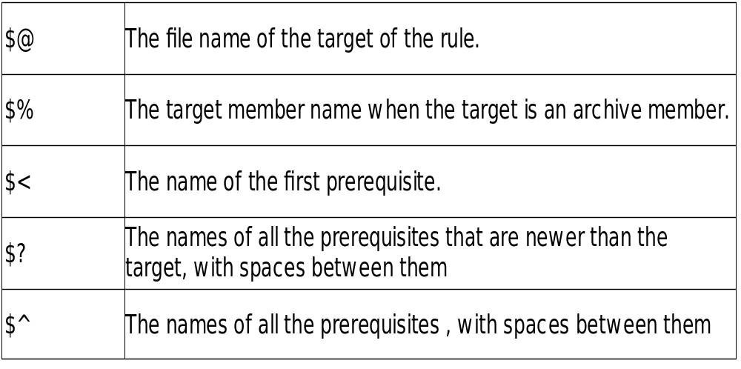
Automatic Variables

Slide 21
Searching Directories for Prerequisites
This feature is used to for searching several directories automatically to find a prerequisite.
When the files are redistributed among directories, rules are not changed, only search paths are changed.
Make variable VPATH specifies a list of directories that make should search.
If a file listed as a target or prerequisite does not exist in the current directory, make searches the directories listed in VPATH.

Slide 22
Searching Directories for Prerequisites
In the VPATH variable, the directory names are seperated by colons or blanks.
Eg:- VPATH = src:../headers
specifies a path containing two directories 'src' and '../headers'

Slide 23
Phony Targets
A Target that is not really the name of a file.
As the rule specifies commands that will not create the target file, the commands will be executed every time the target comes up for remaking.
Example :-
.PHONY : clean
clean :
rm *.o temp

Slide 24
Multiple Targets in a Rule
A rule with multiple targets is equivalent to writing many rules, each with one target.
Example 1 :-
kbd.o command.o files.o : command.h

Slide 25
Pattern Rules
A pattern rule contains the character '%' in the target.The '%' matches any non empty string.
The substring that '%' matches is called the stem.
'%' in a prerequisite of a pattern rule stands for the same stem that was matched by the '%' in the target.
Example :-
  %.c : %.o
  $(CC) -c $(CFLAGS) $^ -o $@

Slide 26
Sample Makefile
CFLAGS = -g -Wall
CC = gcc
LIBS = -lm
OBJS = a.o b.o c.o
SRCS = a.c b.c c.c prog1.c prog2.c
HDRS = abc.h
all: prog1 prog2
prog1: prog1.o $(OBJS)‏
$(CC) $(CFLAGS) -o $@ prog1.o $(OBJS) $(LIBS)‏
prog2: prog2.o $(OBJS)‏
$(CC) $(CFLAGS) -o $@ prog2.o $(OBJS) $(LIBS)‏
.PHONY : clean
clean:
rm *.o

Slide 27
Troubleshooting:
When make is invoked with “-d” option , make display
descriptive messages regarding what made it to choose certain
suffix rules , rebuilt certain file and left other files untouched.
This is helpful in figuring out the problem , why deliverables
are not built properly.
. Option -n : To print the command that would be executed, but do not execute them.

Slide 28
References
Man make
Info make
Http: //172.16.2.50/Technical/OperatingSystem/Tools/Make/make.pdf

Slide 29
Thank you
Global Edge Software Proprietary and Confidential Information
Disclosed Subject to a Nondisclosure Agreement

